Slide 1

CREDIT CARD FRAUD DETECTION
Predicting fraudulent credit card transactions using machine learning classification approach
Asvinta P
16-05-2026

Slide 2
OBJECTIVE
To detect fraudulent credit card transactions using machine learning classification models and to compare multiple classification algorithms and identify the best-performing model.
1
OVERVIEW STEPS
2
Dataset description and Problem definition
Data Preprocessing & EDA
Model Building
Model Evaluation
Key Insights and Recommendations
3

Slide 3
DATASET DESCRIPTION
The dataset contains information regarding customer transaction using credit cards to identify fraudulent and non-fraudulent transactions.
Number of records: 50,000
Features: 10 transaction-related variables such as transaction amount, transaction hour, merchant category, card type, card present, distance from home, transactions in last 24hrs, average transaction amt, and no of times declined.
Target variable: is_fraud (Binary: 1= Transaction is fraudulent,0=Transaction not fraudulent)
Dataset source: Kaggle
1
2
3

Slide 4
UNDERSTANDING THE PROBLEM
Problem definition
Credit card fraud causes significant financial losses for banks, customers, and financial institutions. Detecting fraudulent transactions quickly and accurately is essential to reduce financial risk and improve transaction security.
1
Importance
2
Helps banks prevent financial losses.
Protects customers from unauthorized transactions.
Improves transaction monitoring systems.
Supports real-time fraud detection.
Reduces operational and investigation costs.
3

Slide 5
DATA PREPROCESSING
Data Cleaning: Missing values were identified in 6 features and it was handled by filling with the median and mode of the respective columns.
Encoding: Encoding was performed for categorical columns
Outlier detection and handling: Outliers were detected using IQR technique and handled by using capping method.
Feature Scaling: All independent variables were scaled using StandardScaler to normalize their range.
Oversampling: Applied SMOTE (Synthetic Minority Oversampling Technique) to balance fraud and non-fraud classes.
1
2
3

Slide 6
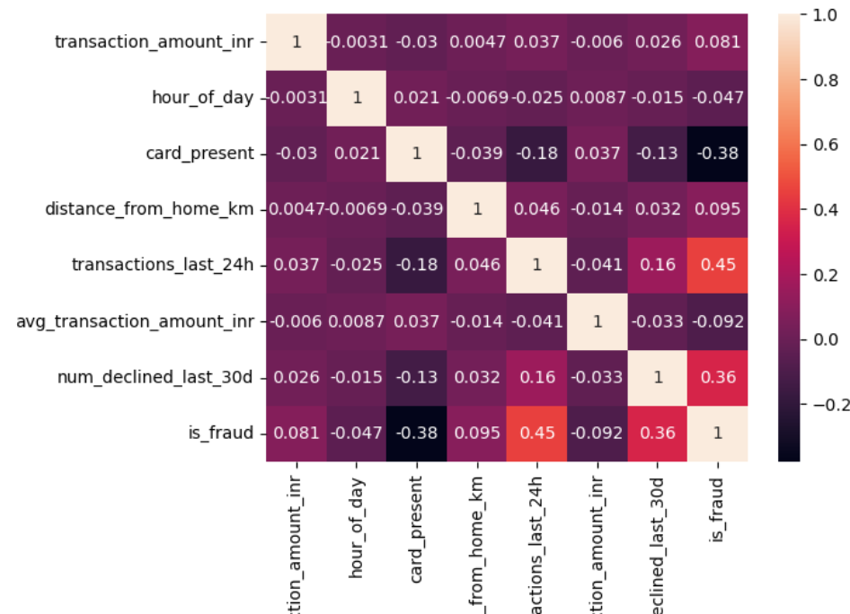
EXPLORATORY DATA ANALYSIS (EDA)
Correlation Heatmap
The heatmap shows the correlation between different transaction features in the dataset.
It helps identify which variables have strong positive or negative relationships with fraudulent transactions.
1
2

Slide 7
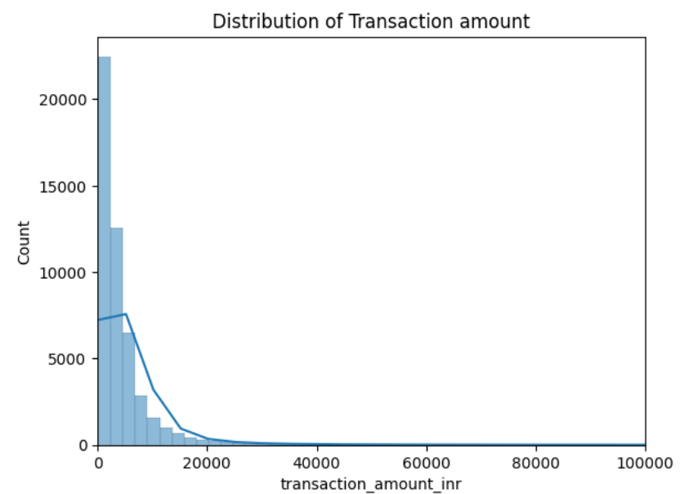
Histogram
The histogram shows the frequency distribution of numerical variables such as transaction amount and average transaction amount

Slide 8
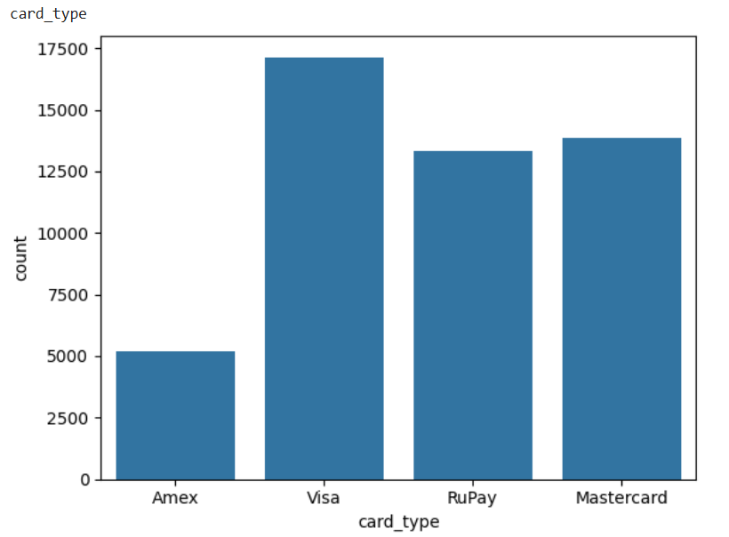
Countplot
1
2
Countplots show frequency of categories within a dataset like card type and merchant category.

Slide 9
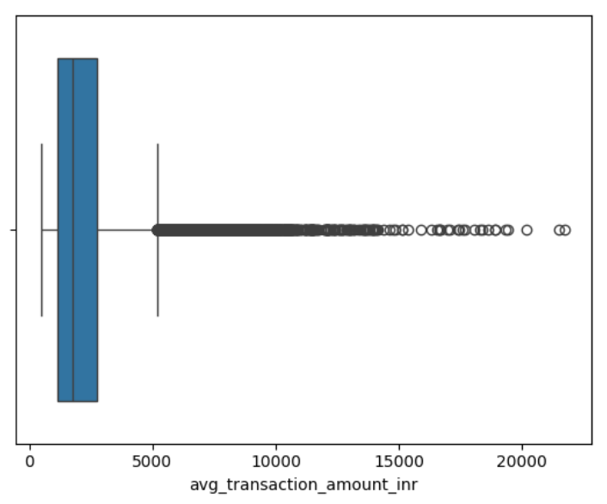
Boxplot
Boxplots are used to detect and visualize outliers. Variables like transaction amt, distance from home, average transaction amt etc have high no of outliers.

Slide 10
MODEL BUILDING
Classification models
Logistic Regression
K-Nearest Neighbors (KNN)
Support Vector Classifier (SVC)
Gaussian Naive Bayes
Decision Tree
Random Forest Classifier
Adaboost Classifier
Gradientboost Classifier
XGBoost Classifier
1
2
3
Training and testing: Data split into training and test sets for model validation.

Slide 11
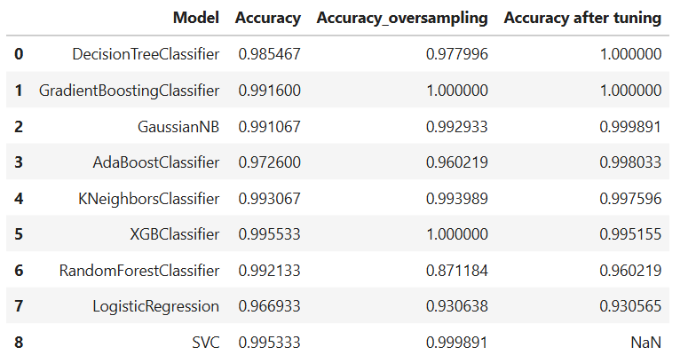
Model Performance
1
2
3
Top performance models are GaussianNB, AdaBoost Classifier,KNN, and XGBClassifier.

Slide 12
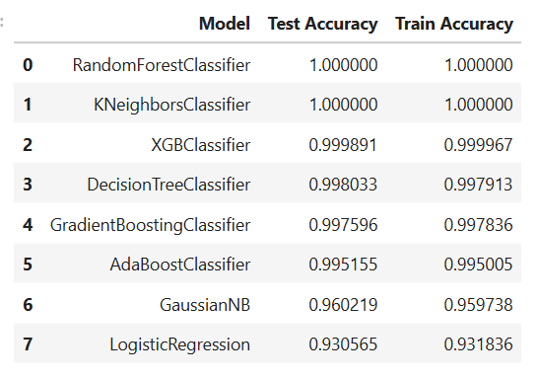
1
2
3
Looking at these models that created the best scores are obtained by the models are XGBClassifier, Decision Tree, Gradient Boost Classifier and AdaBoostClassifier. The model we selected among these is XGBClassifier.

Slide 13
MODEL EVALUATION
Model evaluation was performed on a completely unseen testing set.
Metrics: Accuracy, Precision, Recall, F1-Score, and Confusion Matrix were used, with emphasis on Recall because missing fraud transactions can cause financial loss.
Hyperparameter tuning was conducted using GridSearchCV to find the best parameters and to improve model performance.
1
2
3

Slide 14
INSIGHTS AND RECOMMENDATIONS
Key findings:
The dataset was highly imbalanced, with fraud transactions much lower than non-fraud transactions.
SMOTE oversampling and Hyperparameter tuning using GridSearchCV improved model performance and reduced overfitting.
XGBClassifier was selected for deployment because of its high accuracy, strong fraud detection capability, and better generalization performance.
Features such as transactions in last 24hrs and no of declined transactions played an important role in fraud detection.
1
2
Recommendations:
Use real-time fraud monitoring
Continuously retrain models
Integrate ML fraud alerts into banking system
3

Slide 15
CONCLUSION
This project successfully developed a machine learning-based credit card fraud detection system capable of identifying fraudulent transactions with high accuracy. It effectively addressed challenges posed by missing data and severe class imbalance and handled it welll through preprocessing techniques,oversampling and hyperparameter tuning.
The developed system can support real-time fraud monitoring and help financial institutions reduce financial risk and improve transaction security.
1
2
3

